Slide 1
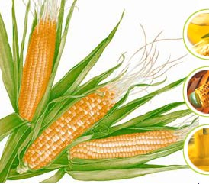
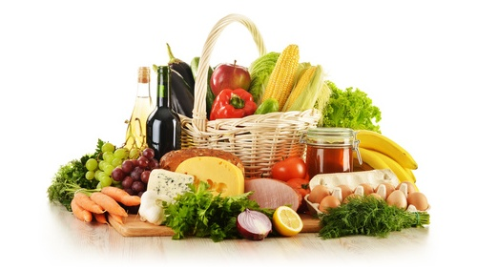
SUKHJIT STARCH & CHEMICALS LTD
Evolving with nature
Investor Presentation 2019

Slide 2
CONTENTS
Business Overview
Product overview
Management Vision and Ethics
Industry Dynamics
Financial Highlights
Strategic Outlook

Slide 3
BUSINESS OVERVIEW
First entry mover advantages: One of oldest producer of Starch in India and third largest in India as per production
Long lasting relationship with biggest brands and end users
Consistent expansion results in huge jump in capacity from 1800 TPA in 1943 to over 5.5 Lacs TPA in 2019-20
Diversification across customers and end-markets
Strong management team with proven track record
Consistent & uninterrupted dividend track record for the last four decades

Slide 4
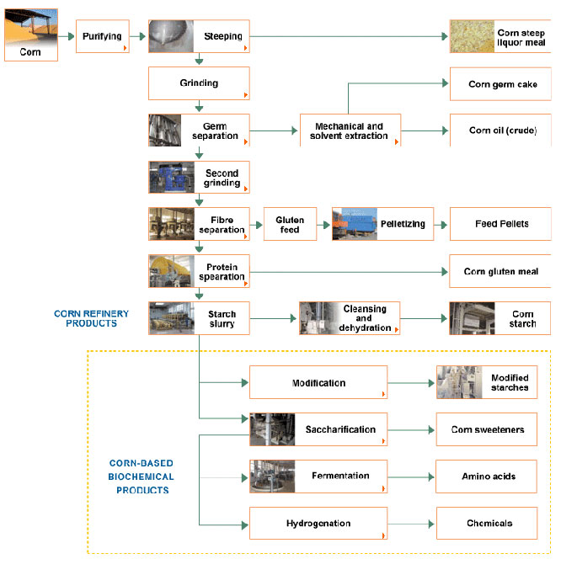
MANUFACTURING PROCESS OF STARCH INDUSTRY

Slide 5
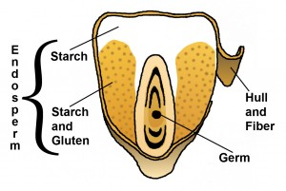
MANUFACTURING PROCESS OF STARCH INDUSTRY
First the incoming corn is inspected and cleaned. Then it is steeped for around 40 hours to begin breaking the starch and protein bonds.
The next step in the process involves a coarse grind to separate the germ from the rest of the kernel.
The remaining slurry consisting of fiber, starch, and protein is finely ground and screened to separate the fiber from the starch and protein.
The starch is separated from the remaining slurry in hydrocyclones. The starch then can be converted to syrup or it can be made into several other products through a Enzymatic / fermentation process.

Slide 6
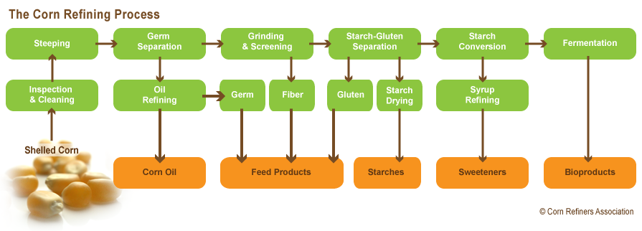
MANUFACTURING PROCESS OF STARCH INDUSTRY

Slide 7
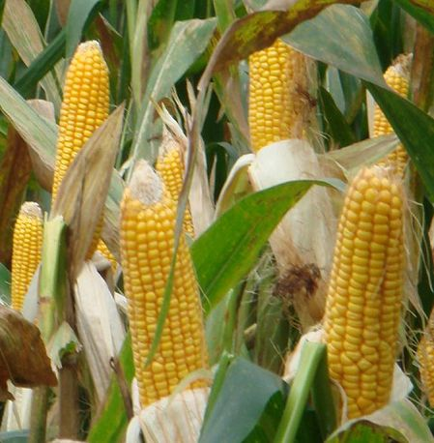
PRODUCT OVERVIEW
Growth of Maize Starch industry in India has almost doubled in terms of grinding capacity of Maize in the last 5 years.
North America is expected to lead the global modified starch market with share of 39 percent followed by Asia-Pacific (29 percent) and Europe (27 percent) in terms of consumption.
Due to opening up of the FDI in Retail sector, more international players likely to penetrate the Indian Market.

Slide 8
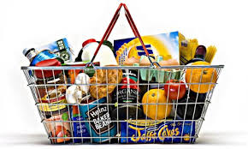
PRODUCT DEMAND OVERVIEW
India with its huge population base and low consumption levels offers a massive opportunity to market starch & starch derivatives
Change in Consumer behavior with respect to habits & patterns of food consumption
Packaged ready-to-eat food is the order of the day due to ready OTC availability: Increase in requirements of modified and value-added starch products i.e. its derivatives, in the packaged food industry
Focus on eco-friendly and readily bio-degradable packaging / products intended to replace single use plastics will spur the demand of starch & starch based bio-polymers

Slide 9
PRODUCT DEMAND OVERVIEW
High-fructose corn syrup, also high-fructose maize syrup in other countries comprises any of a group of corn syrups that has undergone enzymatic processing to convert some of its glucose into fructose to produce a desired sweetness.
Beer industry substituted sugar with High Maltose Corn Syrup (HMCS) and Dextrose, both derivates of Maize Starch.
Manufacturers of Aerated Drinks yet to substitute sugar with an alternative. Enquiry made by manufacturers of Aerated Drinks and Beer, as to an alternative of sugar has increased in last few years.

Slide 10
PRODUCTS: INDUSTRY WISE

Slide 11
PRODUCT USAGE
PRODUCT | USER INDUSTRY
STARCH | TEXTILE, PAPER, FOOD, PACKAGING
DEXTRINE/PRE GEL/MODIFIED STARCH | FOOD, PAPER, PAINT
GLUCOSE | FOOD, FMCG, PHARMA
SORBITOL | PHARMA, PAINT, FMCG
MAIZE GLUTEN/FIBRE/ GERM | ANIMAL, POULTRY FEED, EDIBLE OIL

Slide 12
PRODUCT USAGE

Slide 13
MANIPULATED CORN STARCH USAGE
Extrusion, the same process used to make snack foods, can alter the physical structure of corn starch to make totally biodegradable packaging products. Starch granules can be broken down into nano particles to form adhesives that can replace petroleum-based acetates and alcohols used to help laminate graphics onto cardboard and latexes used as binders in paper coatings.
Corn starch combined with polymers creates a super absorbent used in disposable diapers, sanitary napkins, bandages, and baby powders, and can also be used to remove water from fuels and to clean up pesticide spills.
Corn starches is as raw material for the production of industrial chemicals and plastics which are today made from petroleum feed stocks. As petroleum supplies dwindle or become less reliable, the importance of an abundant source of basic industrial chemicals takes on new proportions. Corn industry scientists are at work on new systems for producing industrial necessities from the versatile corn plant.

Slide 14
FINANCIAL HIGHLIGHTS

Slide 15
FINANCIAL HIGHLIGHTS

Slide 16
FINANCIAL HIGHLIGHTS

Slide 17
INDUSTRY OUTLOOK
India currently has installed starch capacity of over 5 MTPA of starch production): Per capita consumption is still very low: More than 1000 applications in developed countries shows the growth opportunity
Industry is witnessing a burst in activity, leading to several projects to enhance / set up capacity and higher M&A
Larger size plants are preferable to benefit from consolidated procurement and economies of scale in manufacturing. However, smaller plants also have unique advantage due to localised availability of raw-material across the country. Surplus land and good location with access to key raw materials, water and power will allow for scale up
Raw material is subject to price fluctuations as well as production uncertainty
Analysts anticipate this consumption rate to continue in the near future.
China consumption grew by 4 times in last decade

Slide 18
GROWTH DRIVERS
Per capita consumption : Low per capita starch consumption in India of 1.5 kg as compared to global average of 6.1 kg and 1/6 th of the consumption as comparison to China.
Abundant availibility of maize and promoting exports of value added products: Maize production is expected to increase with higher yield
Food/Pharma applications: High price of sugar leading to search for its alternatives in food & beverages industry Steady requirement for glucose / sweeteners.
Rising health consciousness among consumers leading to a higher appreciation of nutritional superiority of products using corn starch & its derivatives
New industrial applications: Modified starch suited for various specific applications resulting in higher efficiency and better quality of end products. E.g. application of cationic starch in paper industry is resulting in lower fiber loss, better printability, etc. Applications of PGS in drilling. Use for starch & starch based bio-polymers in manufacturing ethanol and packaging industry.

Slide 19
STRATEGIC OUTLOOK
Over the next five years, the corn starch market is poised to clip at 4.6% annually in revenue, taking global market to USD 29.20 billion by 2024, up from USD 22.30 billion in 2019.
In some products, the Statutory permissible limit of usage of starch is still very low in India compared to the permissible limits in other American and European countries. Government may consider and thereby make necessary amendments in the permissible limits
Increase in consumption of Maize products can check on the pricing of Sugar and Government may give incentives to starch industry in future
4 industrial sectors ( Pharma, Food and Beverages, Textile & Paper) which are demand driver for the industry are doing extremely well & expected to continue the uptrend in some more years

Slide 20
STRATEGIC OUTLOOK
Our foreign exchange reserves were USD 405.64 billion in the week to March 15, 2019 and have exceeded 449 in the last quarter of Nov 19, according to the RBI data. Our GDP is expected to reach USD 6 trillion by FY27 and achieve upper-middle income status on the back of digitization, globalization, favorable demographics, and reforms.
India is expected to be the third largest consumer economy as its consumption may reach to USD 4 trillion by 2025, owing to shift in consumer behavior and expenditure pattern, according to BCG; and is estimated to surpass the US to become the second largest economy in terms of PPP by 2040, according to PwC.
Macro reforms like GST, bankruptcy code, and setting up of inflation targeting framework are very important ones. We have seen an improvement in ease of doing business. Those are all good measures taken by the government.

Slide 21
CHALLANGES
Consumer industry suffers from fragmented supply: In spite of prices being low, consumer industry have low margins.
Consistent quality of maize is not available round the year: Cost of cultivation is high and not competitive to world price
Capacity to dry corn up to the level of 14% is not present which leads to wastage and loss to farmers.
Post harvest losses are on a rise and quality protein is not available.
Ground water level has gone down substantially
Lack of agriculture sector reforms that many believe should run concurrently even as infrastructure for food processing is set up in the country

Slide 22
WAY FORWARD
Carbohydrate-based products have the potential to improve the sustainability of natural resources, environmental quality and national security while competing economically to expand
INDIA need to build Capacity to dry corn and minimize loss to farmers.
India need to find ways to increase Rabi corn and more focus to be given to post harvest management.
R&D for quality protein is required.
Maize based Intercropping system is the need of the hour.
Productivity needs to be increased through: seed treatment; use of disease resistant maize composites; growing early maturing hybrids; better provision of irrigation resources.

Slide 23
WAY FORWARD
Maize Productivity needs to be increased through: seed treatment; use of disease resistant maize composites; growing early maturing hybrids; better provision of irrigation resources
Globally, as the economies mature there is deceleration in demand growth for sugar and acceleration in growth in demand for starch / starch sweeteners. This structural change is yet to catch up in India, which boasts of a wider gap with per capita sugar consumption of 20 Kgs, against starch consumption of 1.5 Kgs. As the economy matures, Industry expects acceleration in the pace of growth in demand for Starch/Starch sweeteners over the next five to ten years.
Product mix decisions are affected by many factors and economy of scale is a significant one
From the production phase to industrial applications, starch is a perfect raw material to act as a substitute for fossil-fuel components in numerous chemical applications

Slide 24
MANAGEMENT VISION
Quality is the life line of every business and Company committed to satisfy customers by manufacturing & supplying quality products to their entire satisfaction.
Sukhjit is a innovative company : Products, technologies, processes, business models and strategies
Addressing new growth areas: plans to expand strategically
Capable of identifying and using breakthrough innovations
New journey with 2nd generation by exploring fresh possibilities
Increase portfolio of high margin value added products

Slide 25
MANAGEMENT ETHICS
Respect for people and nature.
Deeply committed to the social up-liftment and all round society welfare.
Prevention of environment hazards along with the business/economic growth.
Channelize youth energy for productive use.

Slide 26
SAFE HARBOR
Some of the statements in this document that are not historical facts, are forward-looking statements. These statements entail risks and uncertainties that could cause actual events to differ materially from these forward-looking statements. These risks include, but are not limited to, the level of market demand for our product, market situation for our key inputs, market conditions that could cause our customers to reduce their spending for our products, our ability to create, acquire and build new businesses and to grow our existing businesses and other risks not specifically mentioned herein but those that are common to industry. The Company does not undertake to update these statements publicly to reflect changed eventualities.

Slide 27
IR contact
Reach us : Mr Rishi K, Senior Director
Reliant Investor Relations Consultancy
research@rirc.in
+91 9582111450
+91 75061 31222
+91 11 2244 4422

